Slide 1

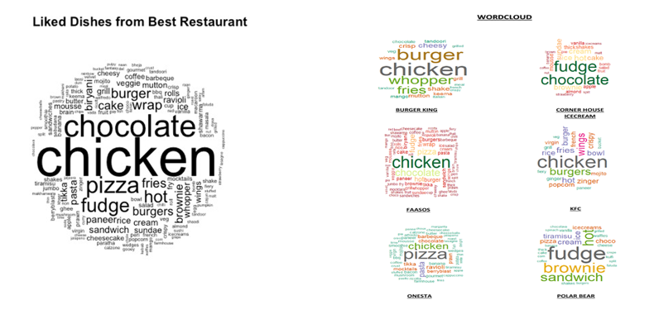
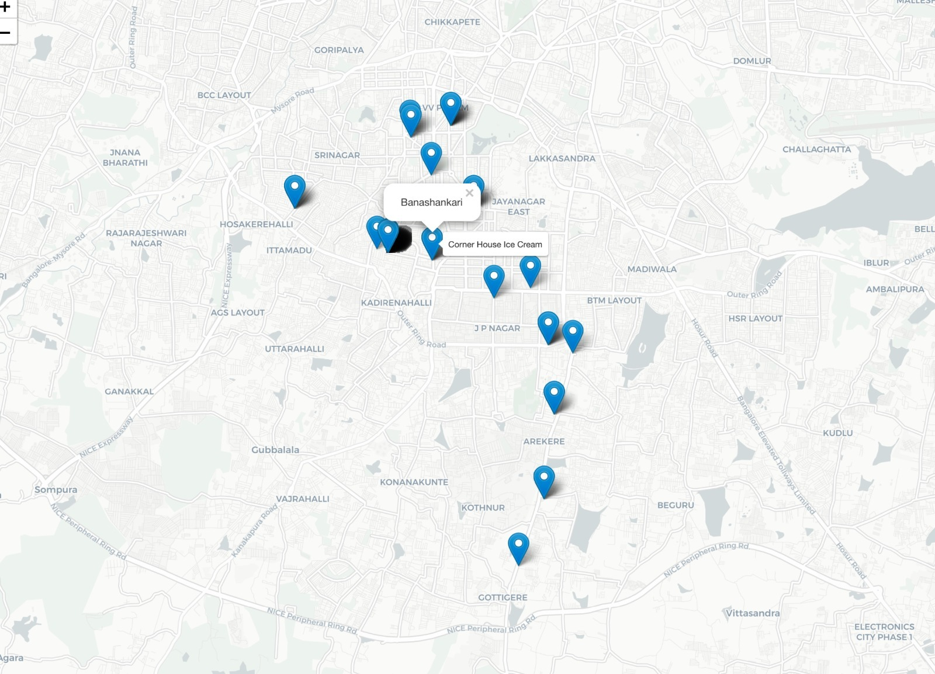
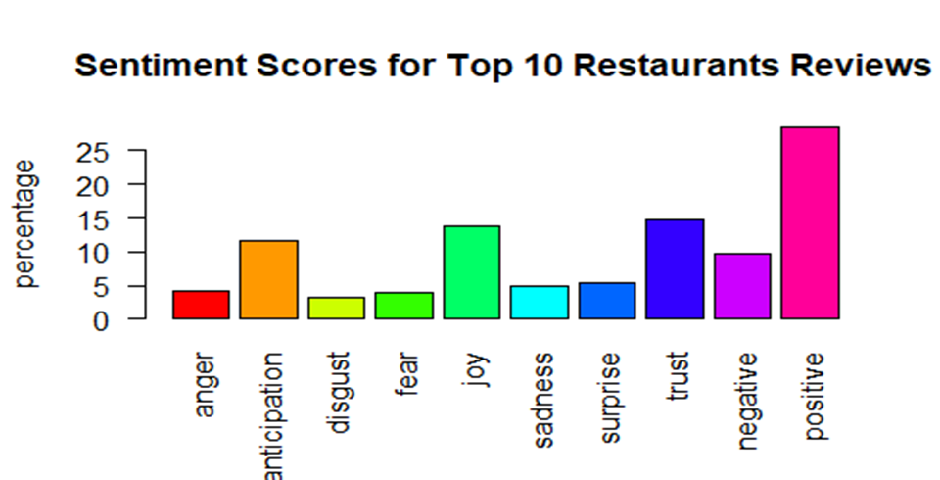
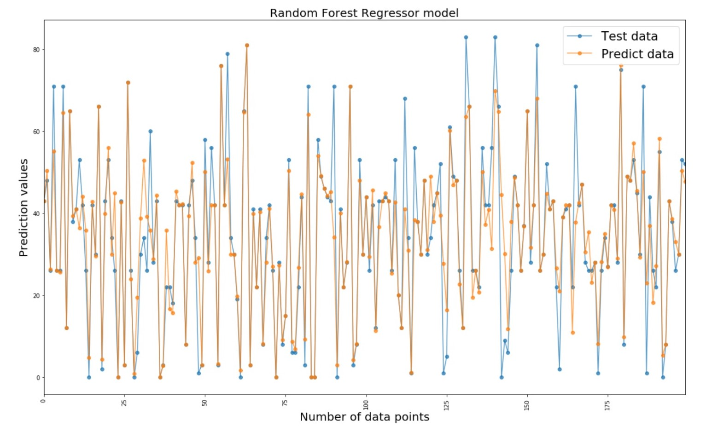
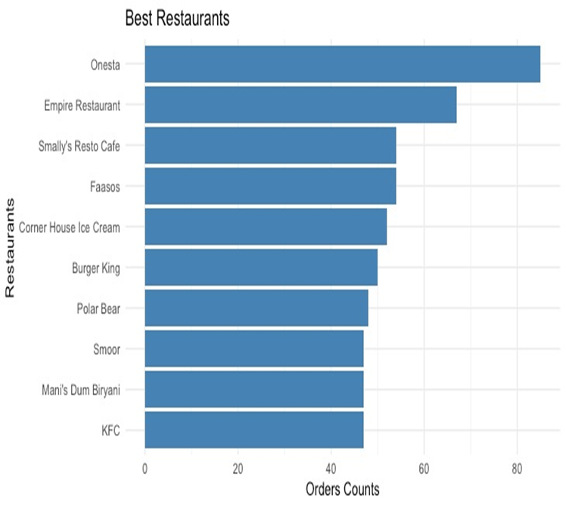
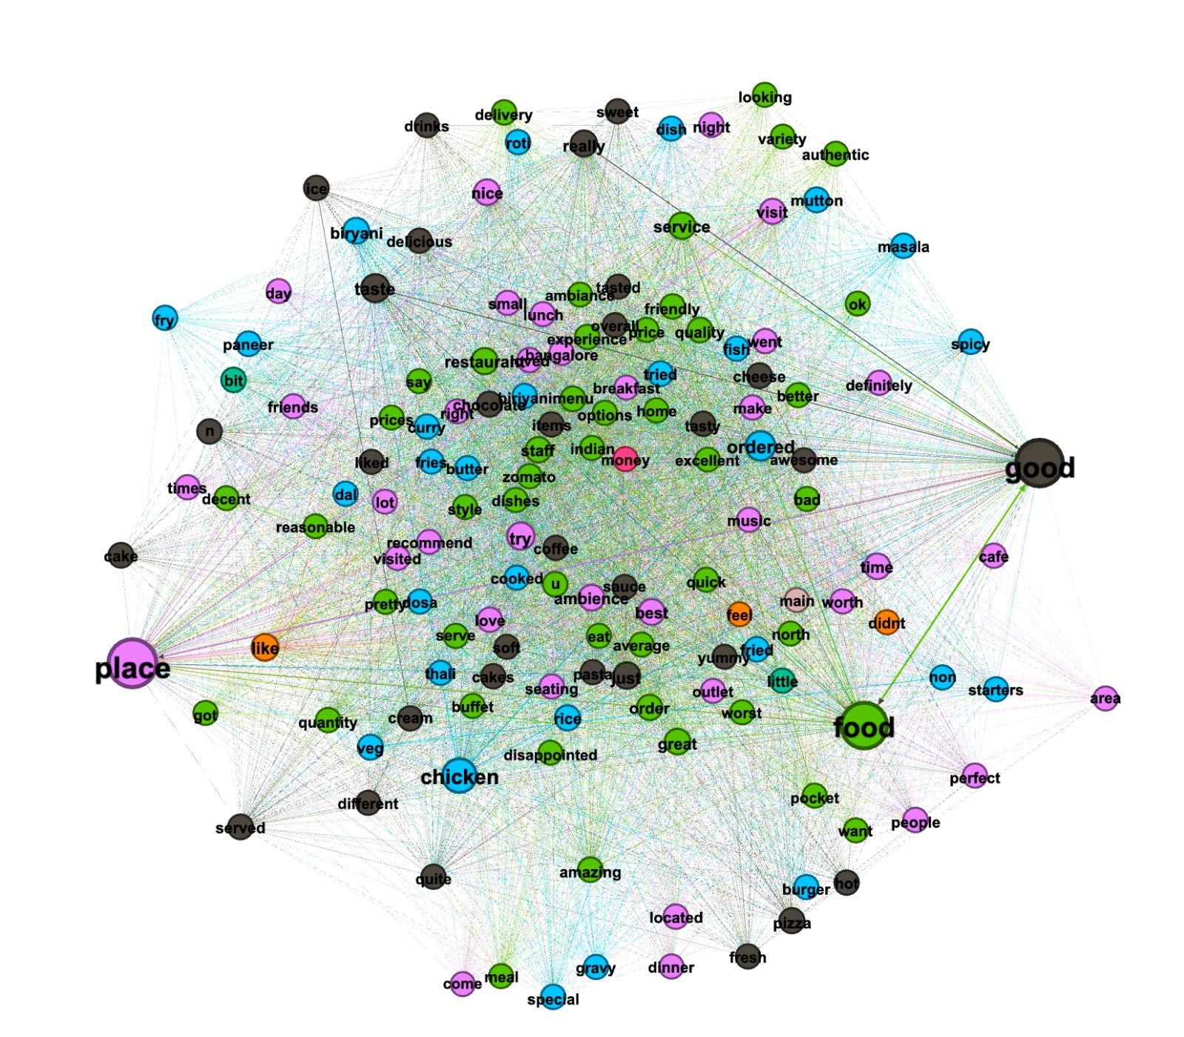
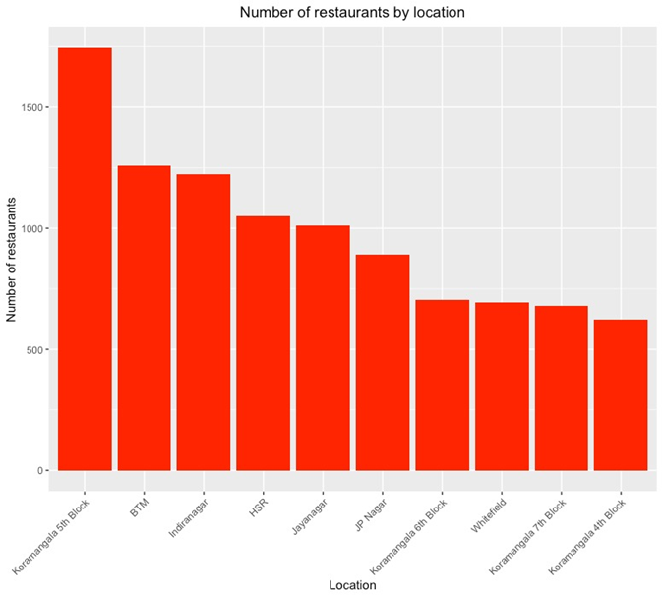
Restaurant Prediction System using R analysis
Abstract
The first wordcloud depicts liked dishes from the top 10 best restaurants while the second one depicts the individual wordcloud for top 10 restaurants. As seen from the wordclouds, chicken, chocolate, burger, pizza etc are the most like dishes. Based on this wordcloud plot, we can recommend our client to put these dishes on the restaurant’s menu list.
Sentiment analysis is acquired from the customer reviews for the top 10 restaurants. Using this sentiment analysis, we can successfully quantify the sentiments of each customer. This can help our client decide which type of restaurant should they pursue and which kind of restaurant is likely to be successful
We have made use of the Gephi software to plot network analysis. To plot the network analysis, we have made use of the column reviews to see the cluster of words coming together. By implementing this, we can understand that there are 3 main hot topics between people which are Food, Place and Good.
The figure above depicts geographical locations of the top 10 restaurants. To plot these locations, we have made use of the Google Application Programming Interfere (API) which helped us to extract the latitude and longitude from the addresses of the top 10 restaurants.
With the help of machine learning algorithms, we have predicted the location as our target variable with respect to the rest of the columns have used various Python libraries such as sklearn and matplotlib to plot our findings. To perform machine learning we have used two data sets which is textual data and numeric data. After Implementing Machine Learning we see that the best accuracy was given by Random Forest
From the above visualizations we can infer the top 10 best locations, type of restaurant, which dishes, and cuisines should an investor select while setting up the restaurants. With the help of visualization, we have seen the top 10 restaurants in Bangalore area had a closer look at their cuisines and for capturing the attention of people/customers investor should include some of the dished which are liked the most by these top restaurants. If we consider our analysis we can help set up a restaurant based on the amount to invest and which location to invest in.
The goal of this project is to analyze and provide prediction results to an India based client who wants to invest in the food and beverage industry. Investing in a restaurant is a successful business as it provides maximum profits. Our client wants to open a restaurant in Bangalore city, and we will help him by providing analysis of different restaurants in Bangalore which are located at different locations by using R analysis. During R analysis, we have performed data manipulation, sentiment analysis, word cloud and network analysis to provide basic graphs and proper visualization of graphs. We have also provided an interactive dashboard to enhance the graphs provided to the client. With the help of this visualization, we will help our client to set up his restaurant in a location which will provide maximum profits.
The above bar graph shows the top 10 restaurant in Bangalore based on order count. This will help our client to understand the competition in the market.
The above bar graph shows the top 10 locations in Bangalore. This plot could recommend our client to select a specific location, depending on the competition and the area in which our restaurant could acquire maximum profit and have more customers.
Analysis
Conclusion

